Slide 1




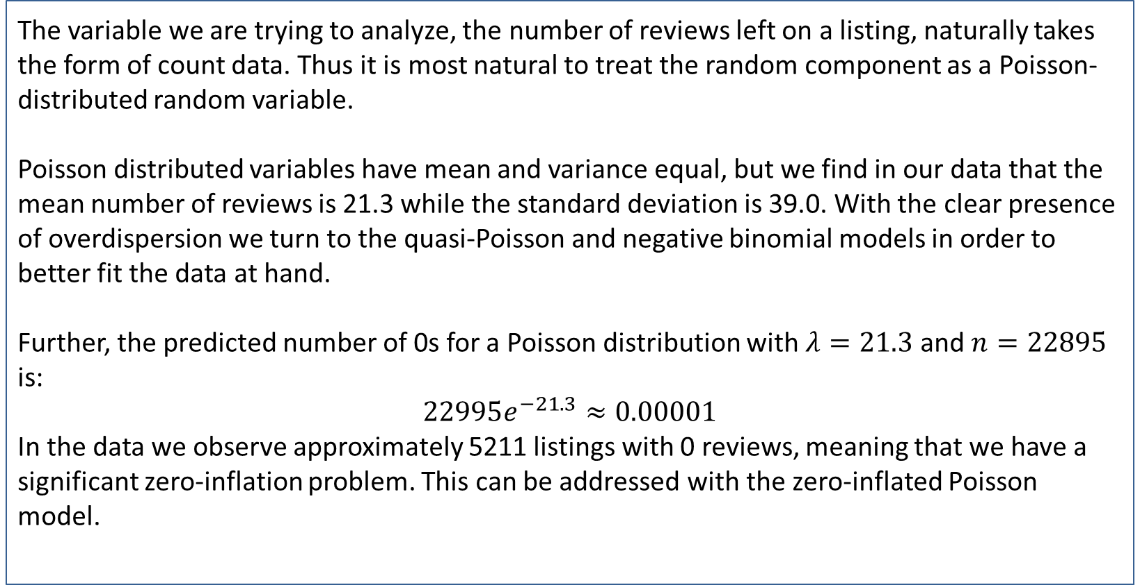
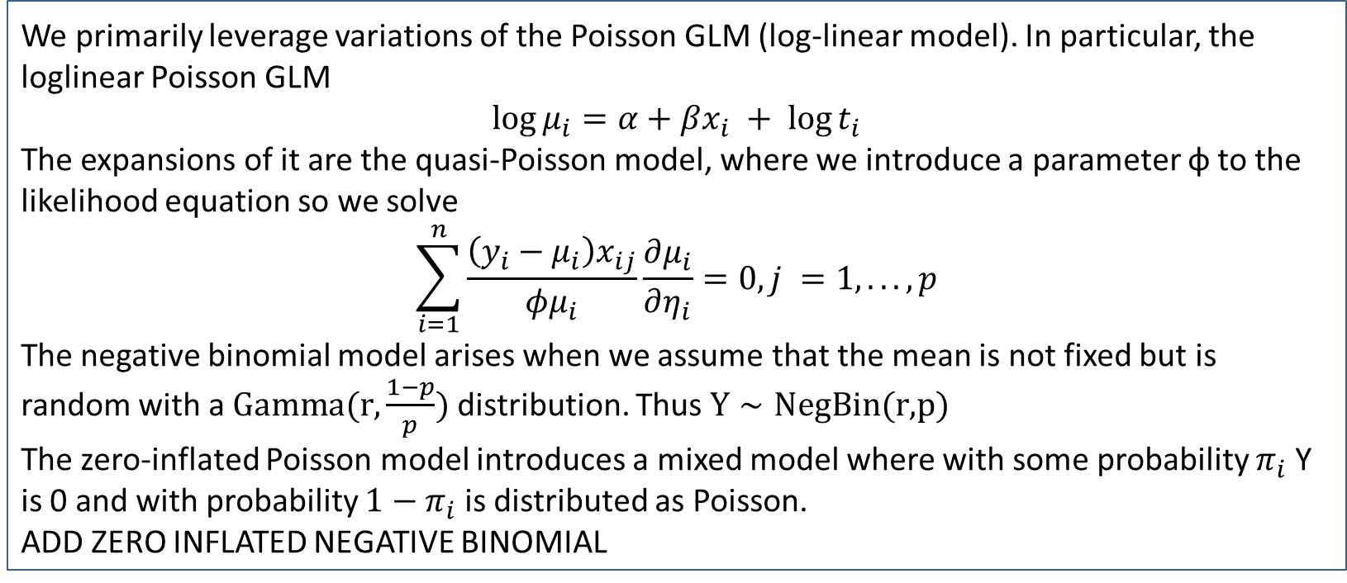
RegressionModeling Using Airbnb Data of Melbourne
Group: 3 Sigma
REPLACE THIS BOX WITH YOUR ORGANIZATION’S
HIGH RESOLUTION LOGO
REPLACE THIS BOX WITH YOUR ORGANIZATION’S
HIGH RESOLUTION LOGO
Xixi Chen; Lixian Chen; George Liu; Yuhao Wang
Columbia University
Abstract
Methods and Materials
We analyze a dataset drawn from AirBnB listings in Melbourne, Australia. In order to understand the drivers of conversion and engagement as measured by review count and predict the number of reviews that a listing is able to generate, we attempt to fit a loglinear model (Poisson GLM) as well as variations in order to deal with overdispersion and zero inflation in the data given a set of predictors.
In particular, because we are not privy to data about bookings given our data is scraped from the AirBnB site, we leverage factors that are likely to be predictors of historic conversion such as price, Instant Book, and availability. We also consider other variables such as months listed and property type that may have effects on reviews independent of conversion.
We primarily leverage variations of the Poisson GLM (log-linear model). In particular, the loglinear Poisson GLM
$$\log{μ_{i}}=α+βx_{i} + \log{t_{i}}$$
The expansions of it are the quasi-Poisson model, where we introduce a parameter φ to the likelihood equation so we solve
$$\sum_{i=1}^{n}{\frac{\left(y_{i}−μ_{i}\right)x_{ij}}{φμ_{i}}\frac{∂μ_{i}}{∂η_{i}}}=0, j =1, ..., p$$
The negative binomial model arises when we assume that the mean is not fixed but is random with a $\text{Gamma}\text{(}\text{r}\text{,}\frac{1−p}{p})$ distribution. Thus $Y∼\text{NegBin}\text{(}\text{r}\text{,}\text{p}\text{)}$
The zero-inflated Poisson model introduces a mixed model where with some probability $π_{i}$ Y is 0 and with probability $1−π_{i}$ is distributed as Poisson.
ADD ZERO INFLATED NEGATIVE BINOMIAL
Chart 1. Label in 16pt Calibri.
Introduction
Results
Discussion
The variable we are trying to analyze, the number of reviews left on a listing, naturally takes the form of count data. Thus it is most natural to treat the random component as a Poisson-distributed random variable.
Poisson distributed variables have mean and variance equal, but we find in our data that the mean number of reviews is 21.3 while the standard deviation is 39.0. With the clear presence of overdispersion we turn to the quasi-Poisson and negative binomial models in order to better fit the data at hand.
Further, the predicted number of 0s for a Poisson distribution with $λ=21.3$ and $n=22895$ is:
$$22995e^{−21.3}≈0.00001$$
In the data we observe approximately 5211 listings with 0 reviews, meaning that we have a significant zero-inflation problem. This can be addressed with the zero-inflated Poisson model.
Ran Poisson, negative binomial Poisson, quasi-Poisson, zero-inflated Poisson, zero-inflated negative binomial
Using Vuong test, determined that
negative binomial > Poisson
Negative binomial > zero-inflated Poisson
Zero-inflated negative binomial > negative binomial
Zero-inflated negative binomial > zero-inflated Poisson
Zero-inflated negative binomial > Poisson
Quasi-Poisson estimation output hard to understand. Output nearly identical to Poisson, overdispersion parameter very large
Click here to insert your Discussion text. Type it in or copy and paste from your Word document or other source.
This text box will automatically re-size to your text. To turn off that feature, right click inside this box and go to Format Shape, Text Box, Autofit, and select the “Do Not Autofit” radio button.
To change the font style of this text box: Click on the border once to highlight the entire text box, then select a different font or font size that suits you. This text is Calibri 20pt and is easily read up to 3 feet away on a 24x36 poster, and up to 6 feet away on a 48x72 poster.
Zoom out to 100% (for 24x36) or 200% (for 48x72) to preview what this will look like on your printed poster.
Conclusions
Click here to insert your Conclusions text. Type it in or copy and paste from your Word document or other source.
This text box will automatically re-size to your text. To turn off that feature, right click inside this box and go to Format Shape, Text Box, Autofit, and select the “Do Not Autofit” radio button.
To change the font style of this text box: Click on the border once to highlight the entire text box, then select a different font or font size that suits you. This text is Calibri 20pt and is easily read up to 3 feet away on a 24x36 poster, and up to 6 feet away on a 48x72 poster.
Zoom out to 100% (for 24x36) or 200% (for 48x72) to preview what this will look like on your printed poster.
Table 1. Label in 16pt Calibri.
 | Heading | Heading | Heading
Item | 800 | 790 | 4001
Item | 356 | 856 | 290
Item | 228 | 134 | 238
Item | 954 | 875 | 976
Item | 324 | 325 | 301
Item | 199 | 137 | 186
Figure 1. Label in 16pt Calibri.
Figure 2. Label in 16pt Calibri.
Contact
References
Lixian Chen
Department of Statistics, Columbia University
Email: lc3359@Columbia.edu

